Slide 1


Slide 2

ABOUT US
Embark on a Journey of Pioneering Innovations with CAN-ECO
At CAN-ECO, we're catalysts for change. Through relentless research and development, we pioneer solutions optimizing fossil fuel consumption. From gasoline to diesel and natural gas, our innovations drive efficiency while honouring our environmental stewardship.

Slide 3


Innovative Hydrogen Nanocell Technology: A Leap in Efficient Energy Consumption
Innovative hydrogen nanocell technology by CAN-ECO delivers highly efficient electrolysis with minimal energy input. Our process seamlessly integrates Oxy-Hydrogen (HHO) molecules into internal combustion engines, exemplifying our commitment to eco-efficient energy solutions.

Slide 4
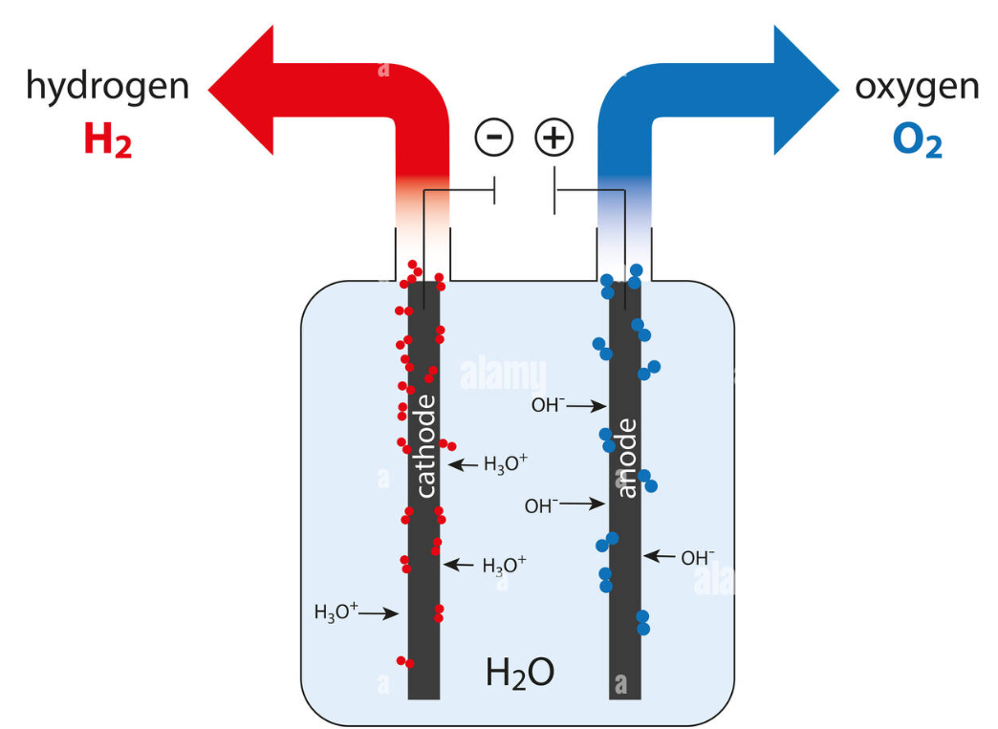
TECHNOLOGY
Leveraging advanced hydrogen nanocell technology, our system operates with unprecedented efficiency, requiring remarkably low energy input for electrolysis. This sophisticated process meticulously extracts Oxy-Hydrogen (HHO) molecules from water, then ingeniously integrates these molecules into internal combustion engines as a natural additive. This innovation not only enhances engine performance but also aligns with our commitment to environmental sustainability by optimizing fuel efficiency and reducing emissions.

Slide 5
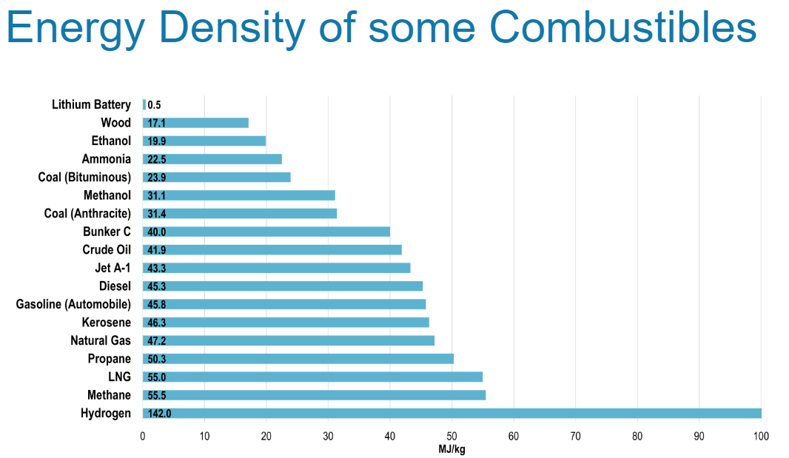
FACTS
Hydrogen Gas is a potent fuel known for its energy density. When integrated into combustion processes alongside gasoline, diesel, or natural gas, it enhances efficiency remarkably. Embracing this technology enables a harmonious blend of environmental responsibility and cost-effectiveness, facilitating business decarbonization and substantial fuel savings.

Slide 6






HYDROGEN SYSTEM BENEFITS
Saving fuel expenses up to 30%
Reducing emissions up to 78%
Reducing engine wearing
Reducing engine noise
Cleans the engine of carbon deposits
Connectivity to our Fleet Management system at your request

Slide 7
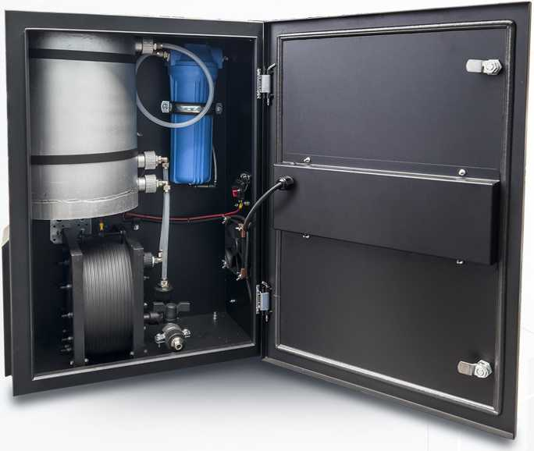
PLUG AND PLAY
Our truck systems are designed with a 'Plug and Play' interface, ensuring a seamless integration process. This feature enables 90% pre-installation by our team, minimizing the potential for errors during the final setup and expediting operational readiness.
Each system is enhanced with a proprietary Nano-coating technology, which ensures prolonged operational life, augmented efficiency, and increased resilience. This application serves to safeguard the system against the rigors of extended use and environmental factors, thereby optimizing performance and reliability.

Slide 8

SCHEME OF OPERATION
At the heart of our business infrastructure lies the Dynamic PWM, a pivotal and groundbreaking element that facilitates seamless and fully automated control over our operational processes. This cutting-edge technology precisely modulates hydrogen gas production in alignment with various vehicular metrics and the charging infrastructure. Such precision enables us to achieve comprehensive power optimization, resulting in exceptional performance outcomes.

Slide 9





ECONOMIC BENEFITS
10 TO 30
REDUCTION IN FUEL CONSUMPTION
UP TO 51
REDUCTION IN DEF
(DIESEL EXHAUST FLUID)
UP TO 25
ESTIMATED REDUCTION
ON OIL CHANGES

Slide 10



TECHNICAL BENEFITS
7 - 15
UP TO 51
33
UP TO 25
More Power/Torque
Lower consumption of Adblue
Less carbon deposits
Smoother and quieter engine performance

Slide 11
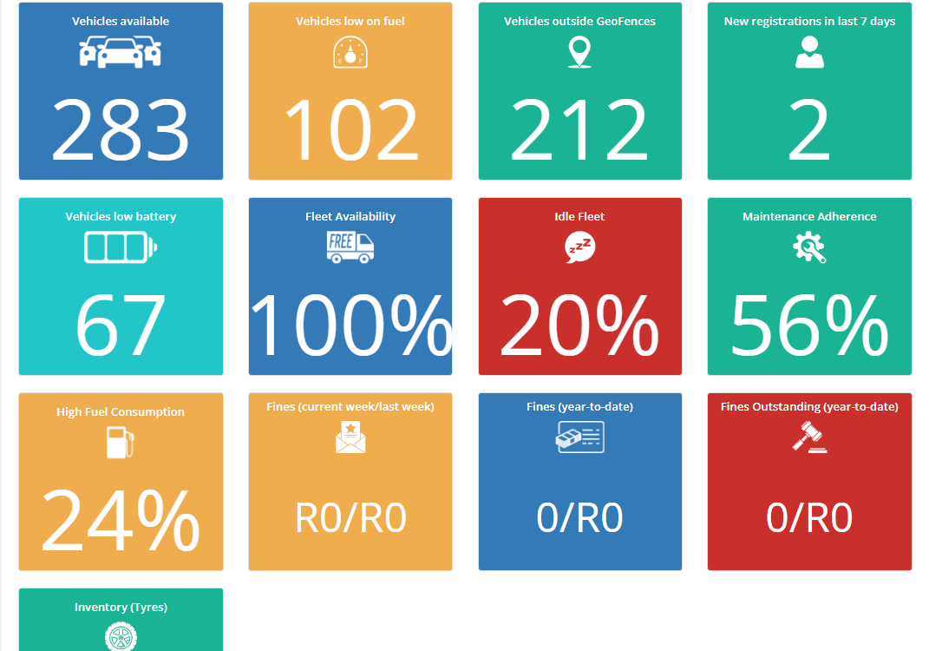
FLEET MANAGMENT
We provide the option of integrating seamless connectivity with our Fleet Management System upon your request. This functionality affords extensive oversight of your fleet, presenting real-time data and analytics that demonstrate the efficacy of our fuel-saving initiatives. Maintain command, enhance operational performance, and elevate efficiency with CANFLEET Systems. We believe that well-informed decisions are the cornerstone of advancing towards a greener and more sustainable future.

Slide 12





EXAMPLE 20% SAVING
TRADITIONAL COSTS
AVG FUEL PRICE PER LITRE
R22.92
AVG FUEL PRICE PER LITRE
R22.92
AVG FUEL SPEND PER 100KM
50 LITRES
AVG FUEL SPEND PER 100KM
50 LITRES
– 20% (10L)
40LITRES
COST OF FUEL PER 100KM
R1 146.00
COST OF FUEL PER 100KM
R916.80

Slide 13
YEARLY EXAMPLE 20% SAVING
TRADITIONAL COSTS
AVG FUEL PRICE PER LITRE
R22.92
AVG FUEL PRICE PER LITRE
R22.92
FUEL CONSUMED PER YEAR
50 000 LITRES
FUEL CONSUMED PER YEAR
50 000 LITRES
– 20% (10 000L)
40 000 LITRES
COST OF FUEL PER YEAR
R1 146 000.00
COST OF FUEL PER YEAR
R916 800.00

Slide 14

CONTACT US
Kevin@cancomsa.co.za / 082 552 9138

